Slide 1


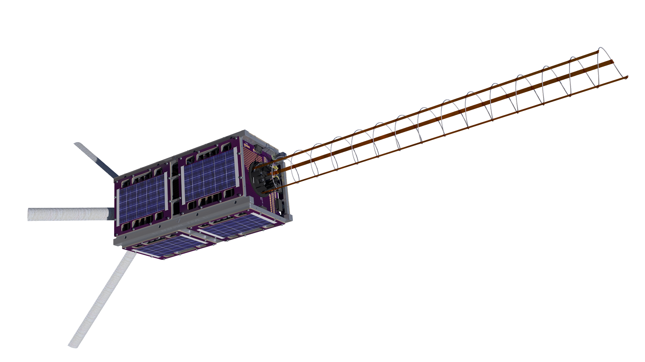

OreSat Deployable Antennas
John George ∘ Paijanne Jones ∘ Calvin Young ∘ Justin Burris ∘ Shivani Nadarajah
2018
Capstone Assignment
Design and manufacture two separate antenna deployment systems for Oregon’s first satellite
Oregon Small Satellite Project

Slide 2
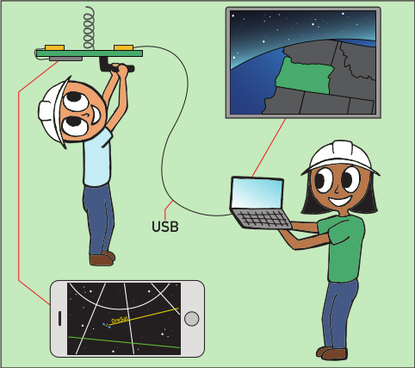

OreSat Deployable Antennas
2018
Primary Mission
Space-based STEM outreach
Work with K-12 students to build trackers
Stream live video to handheld receivers
Citizen science project with secondary mission
Give college students experience in aerospace...
Secondary Mission
Cirrus flux camera
Scientists from the University of Oregon
Top-down view of high-altitude cirrus clouds
Research to improve climate models
Oregon Small Satellite Project

Slide 3

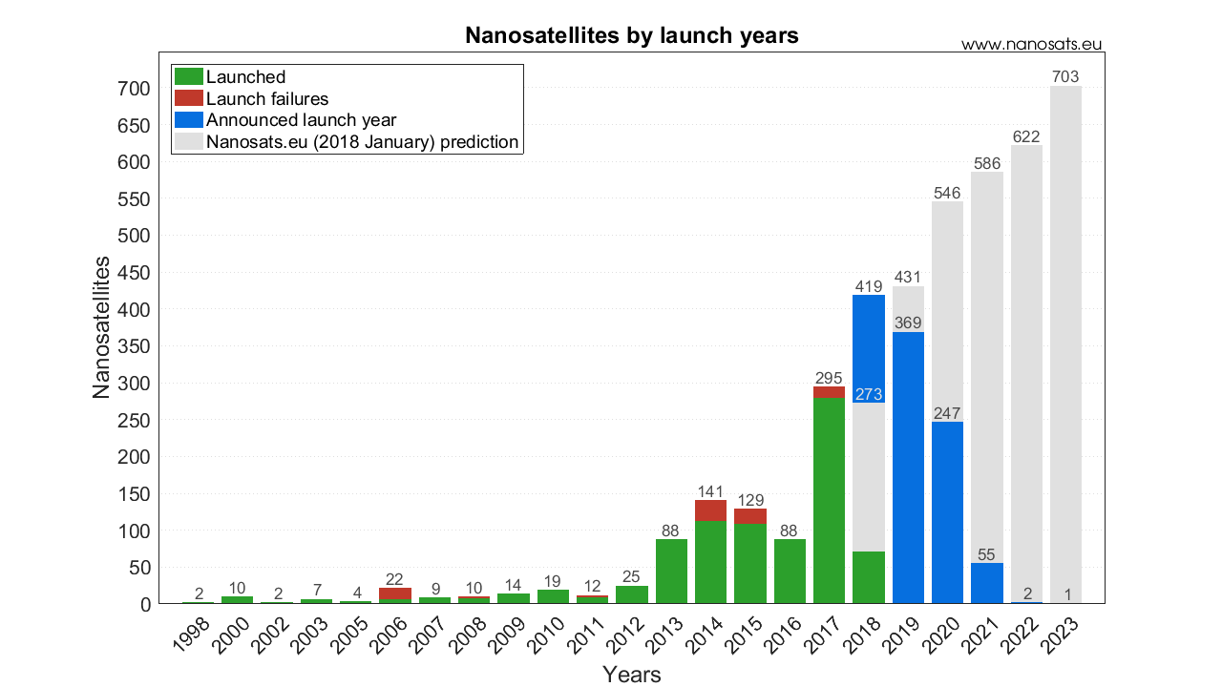
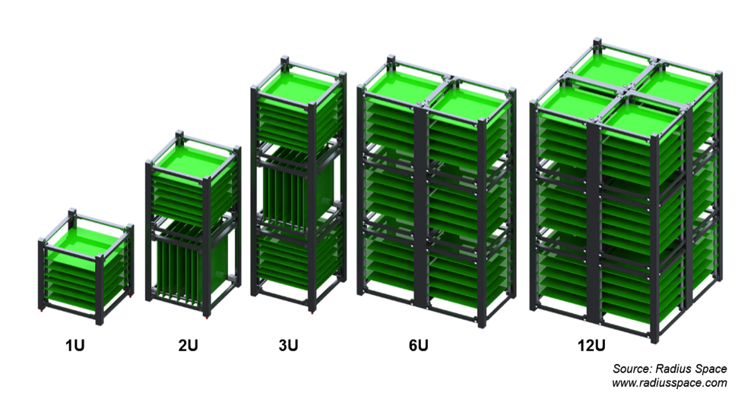
OreSat Deployable Antennas
2018
OreSat is a CubeSat
Specification defined by Cal Poly in 1999
Set of standards to simplify design and integration
Lowered the barrier to entry for university groups
Based on 100 mm cube units
Compared to full-size (100’s or 1000’s of kg) satellite
Oregon Small Satellite Project

Slide 4



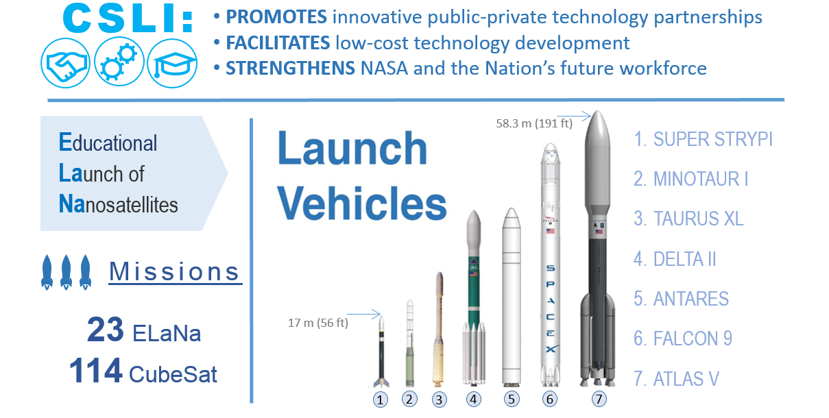

OreSat Deployable Antennas
2018
Getting to Space
Selected by NASA’s CubeSat Launch Initiative (CSLI)
Hand-off to NanoRacks for testing and integration
Launch to ISS on commercial resupply mission
Deploy into low Earth orbit
Decay in 6-12 months
Oregon Small Satellite Project

Slide 5
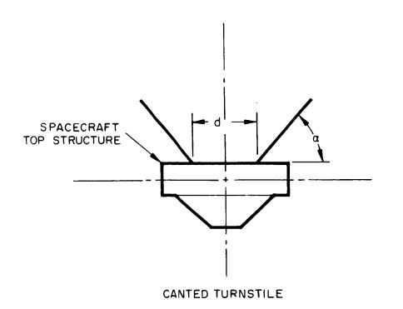
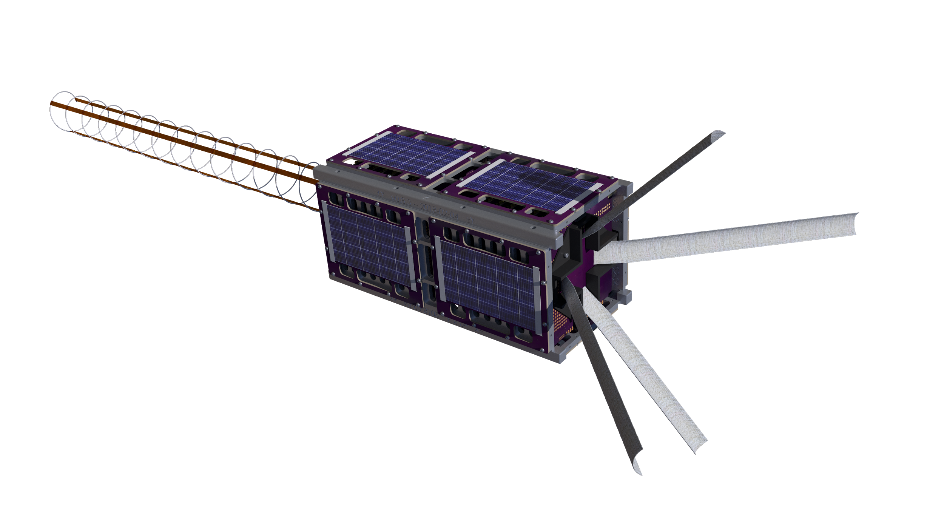
OreSat Deployable Antennas
2018
Canted Turnstile Array
Oregon Small Satellite Project

Slide 6
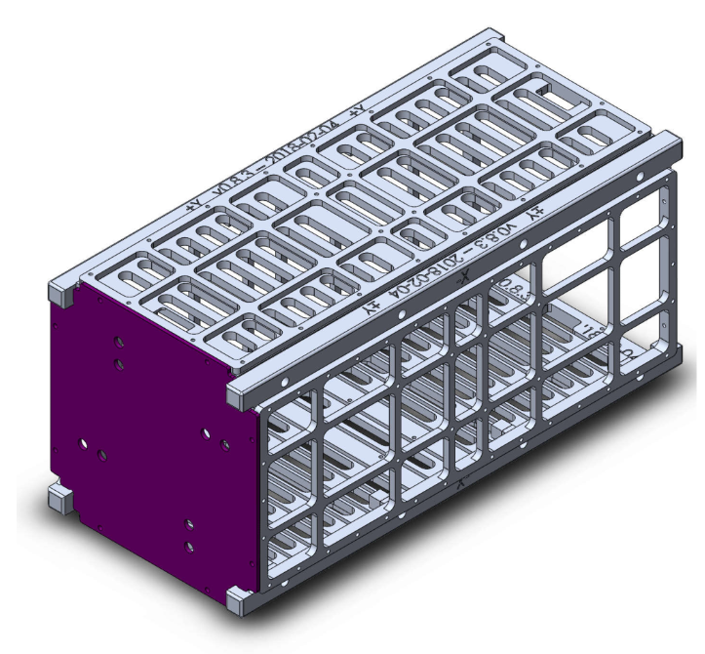
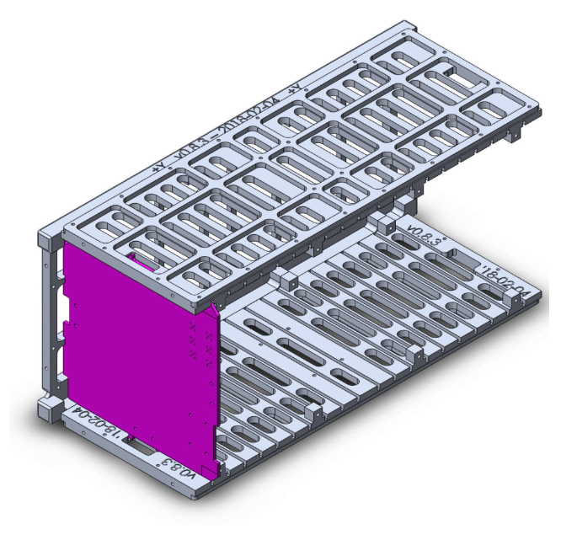
OreSat Deployable Antennas
2018
Design Constraints
Fits on end cap
Stows under 7mm high
Fits on end card
Stows under 17mm high
OR
Able to be stowed for up to 6 months and still deploy reliably
Able to withstand harsh launch and orbital environments
2 poles to be 140mm in length
2 poles to be 190mm in length
Deploy between 15 and 60 degrees off the plane
Oregon Small Satellite Project

Slide 7
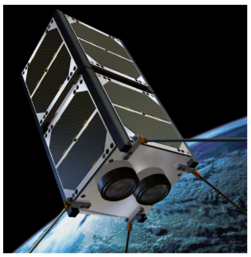
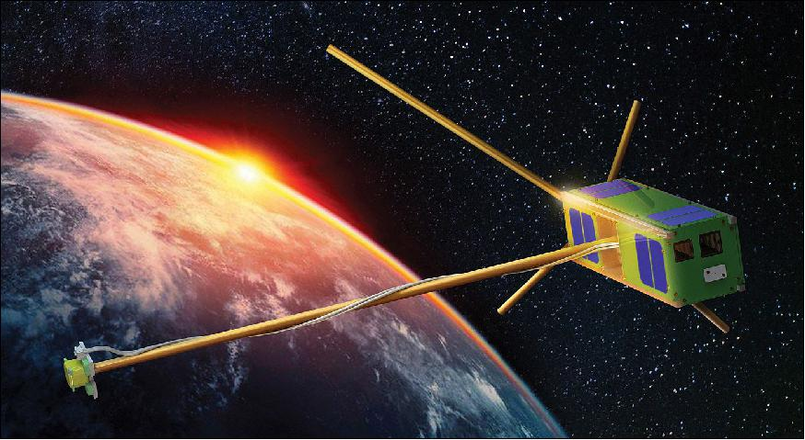
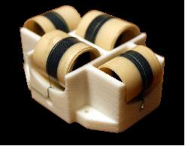
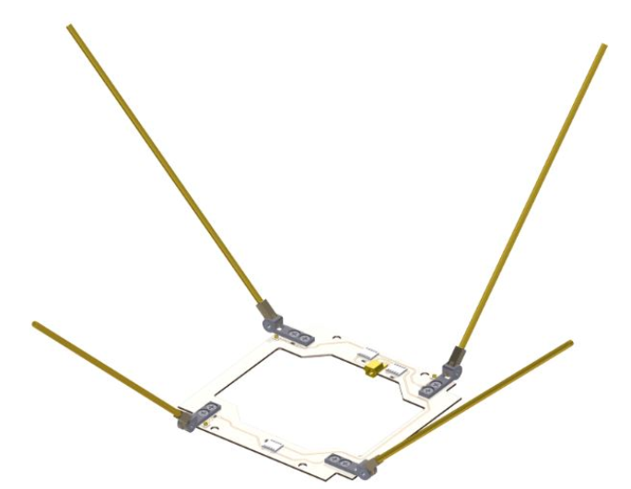
OreSat Deployable Antennas
2018
Inspiration
GOMspace Nanocom ANT430
ELFIN (Electron Losses and Fields INvestigation)
Oregon Small Satellite Project

Slide 8
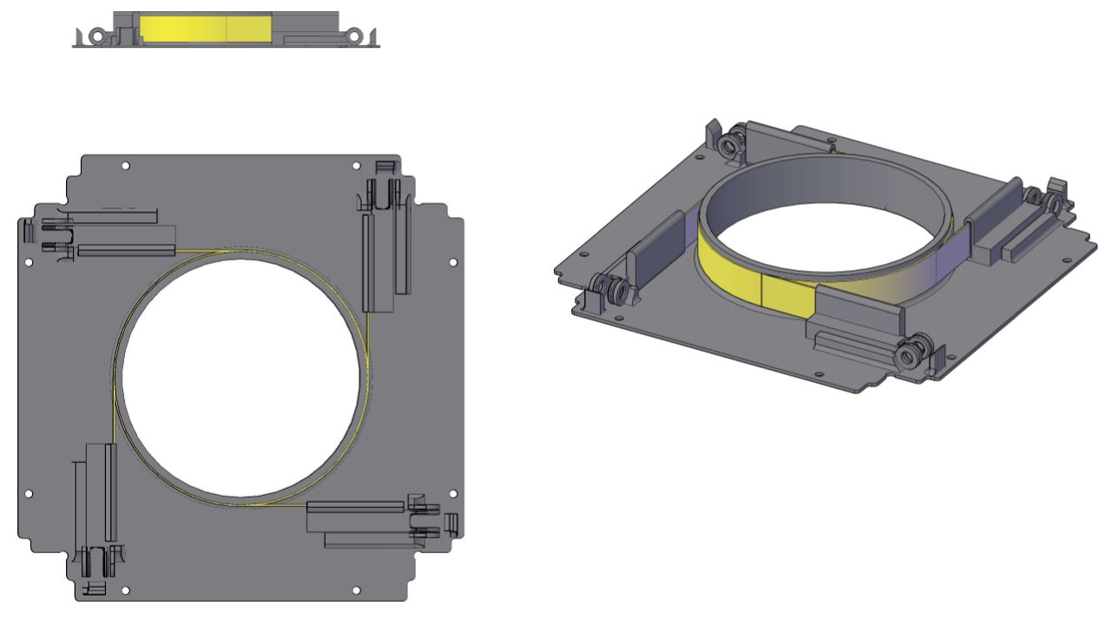
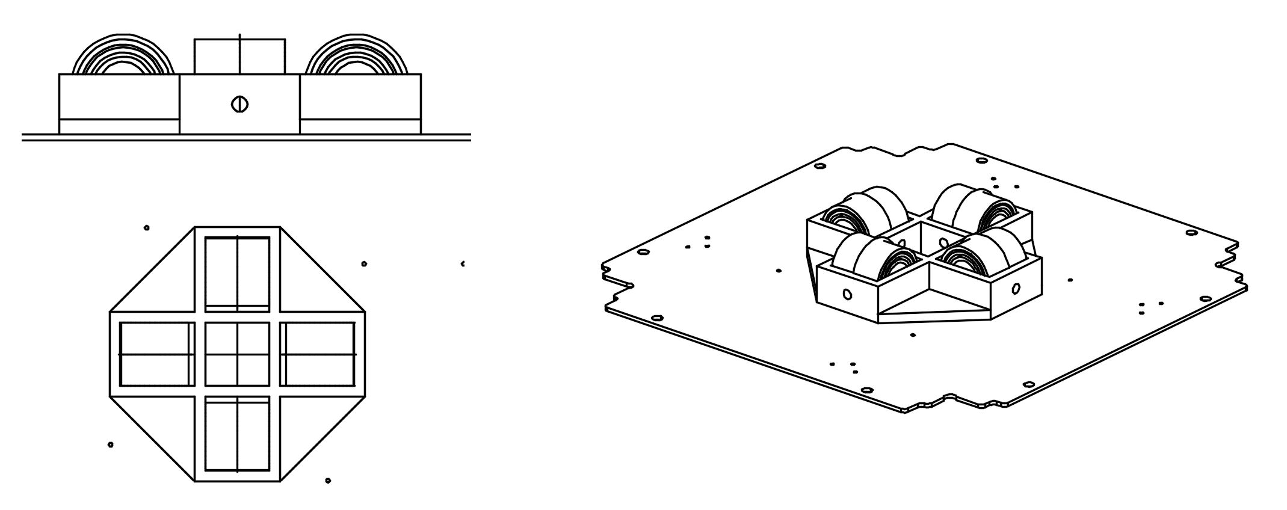
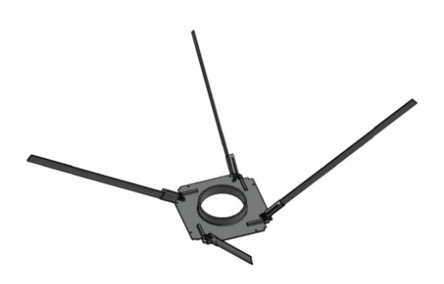
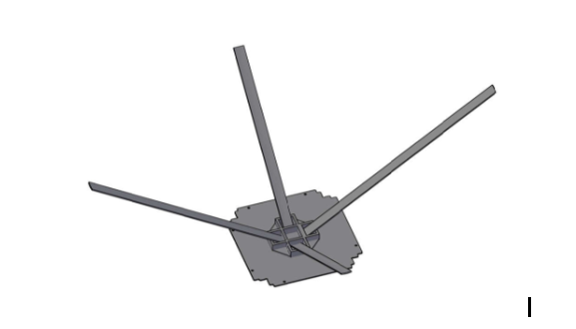
OreSat Deployable Antennas
2018
Tape Measure Prototypes
Hinge Design
Roll-up Design
Torsion spring hinge
Steel tape spring poles
Steel tape spring poles
Oregon Small Satellite Project

Slide 9
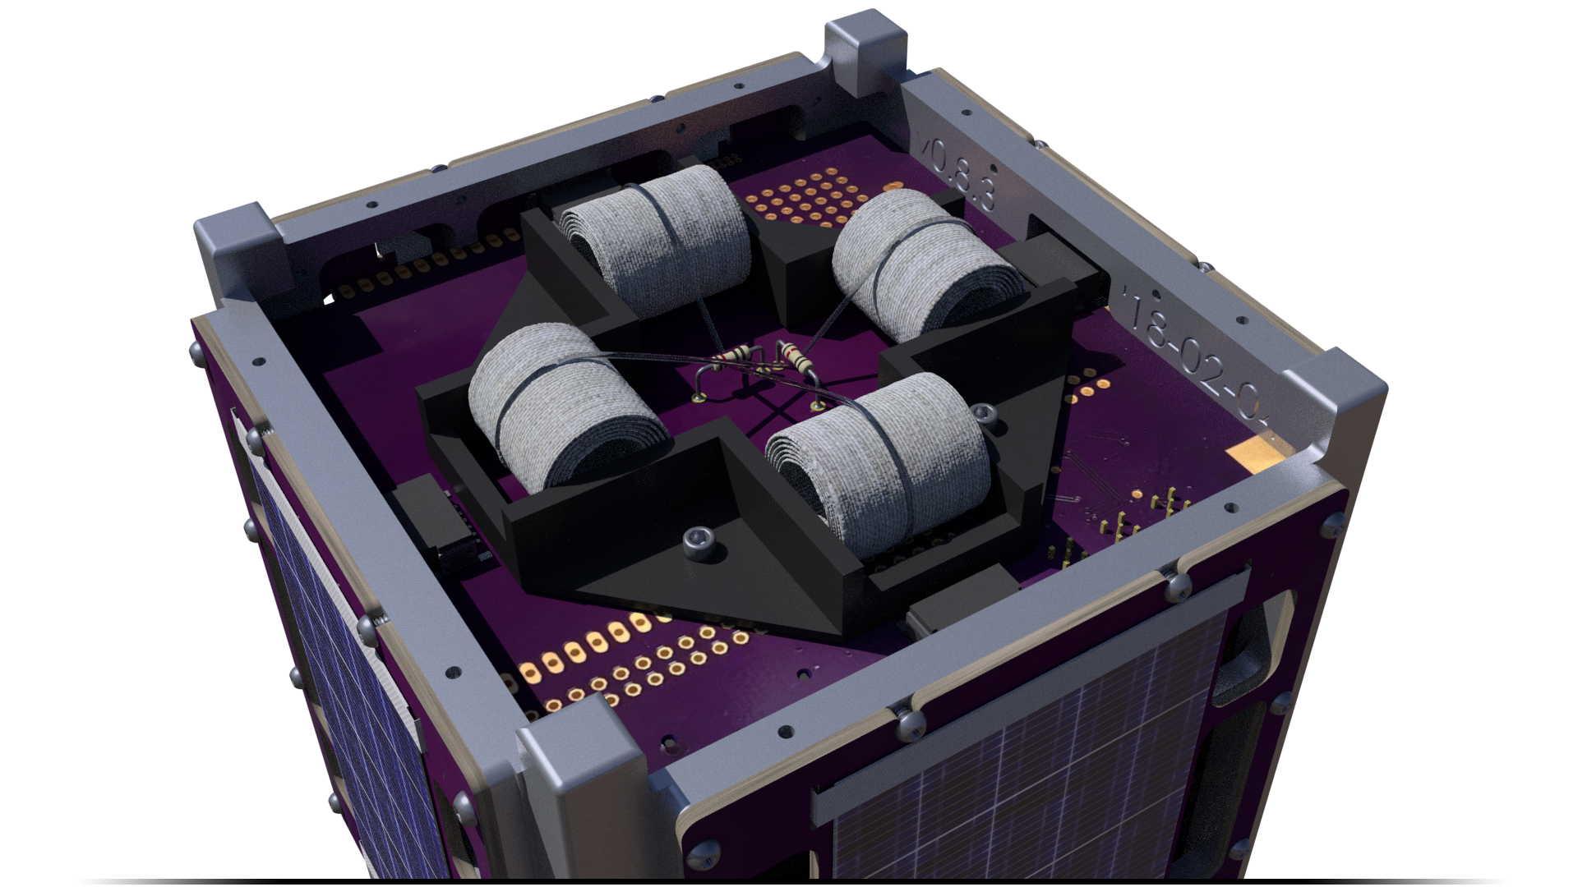
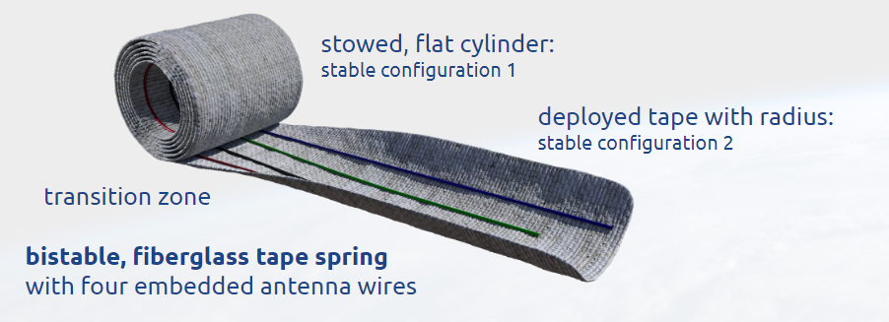
OreSat Deployable Antennas
2018
Updated Requirements and Design
Layered, non-conductive fiberglass tape springs
Bistable configuration
4 embedded wires per pole
End card mount (17mm stowed height)
Stowed configuration
Deployed configuration
Oregon Small Satellite Project

Slide 10
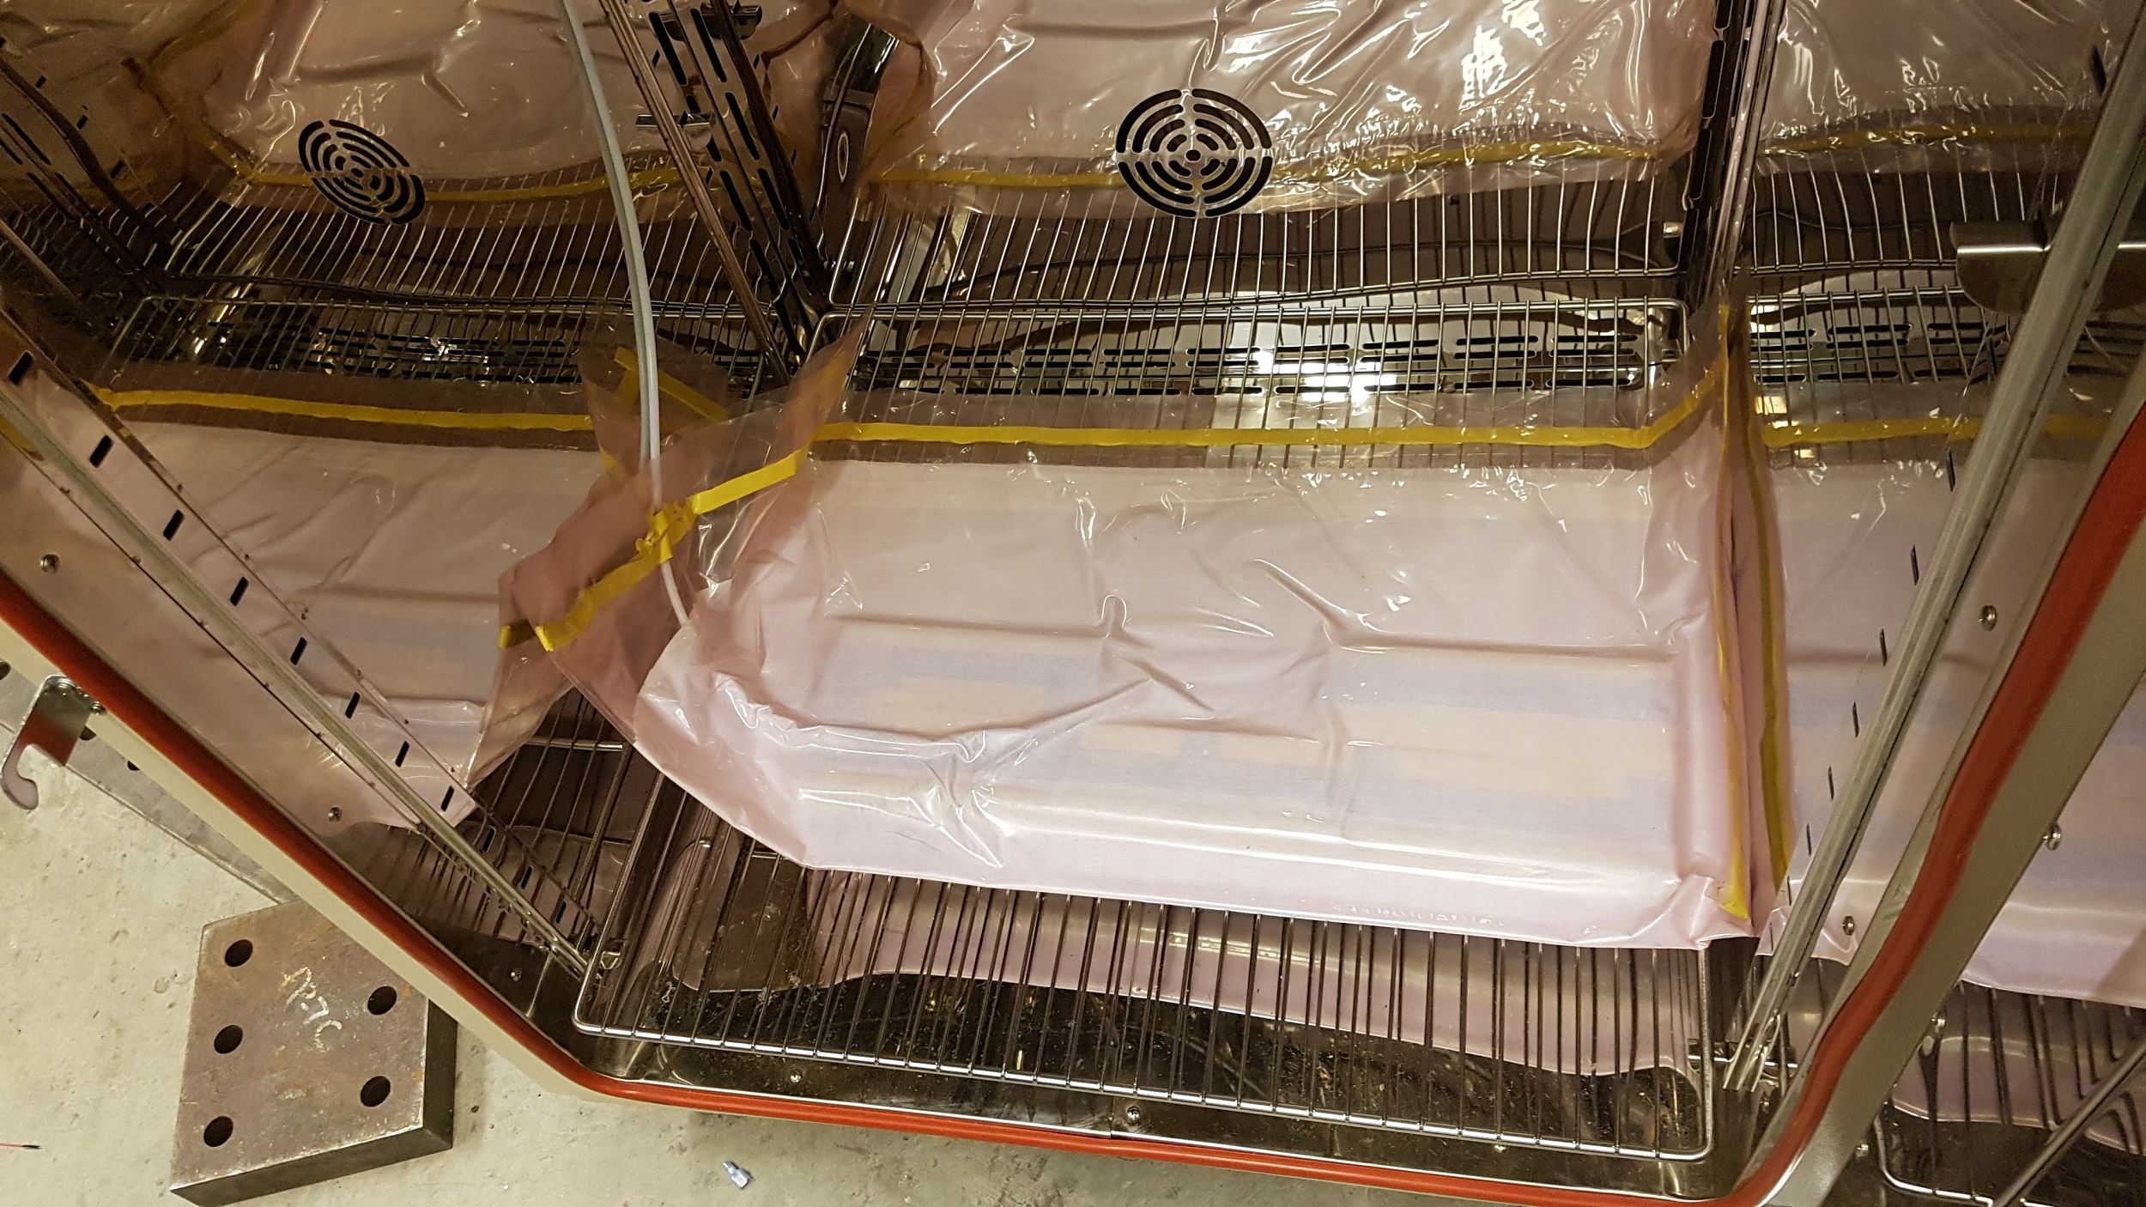
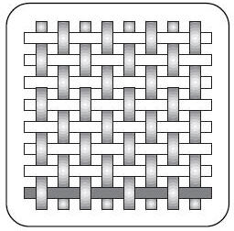
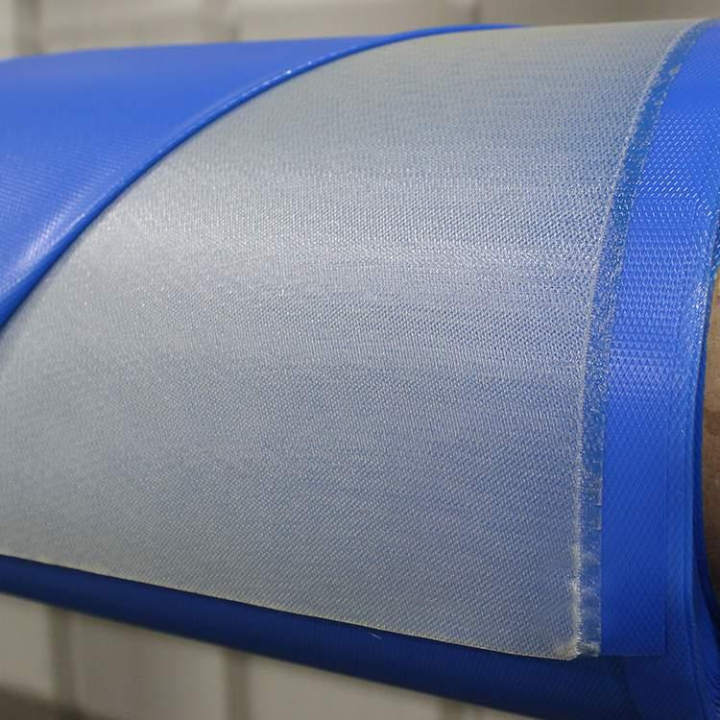
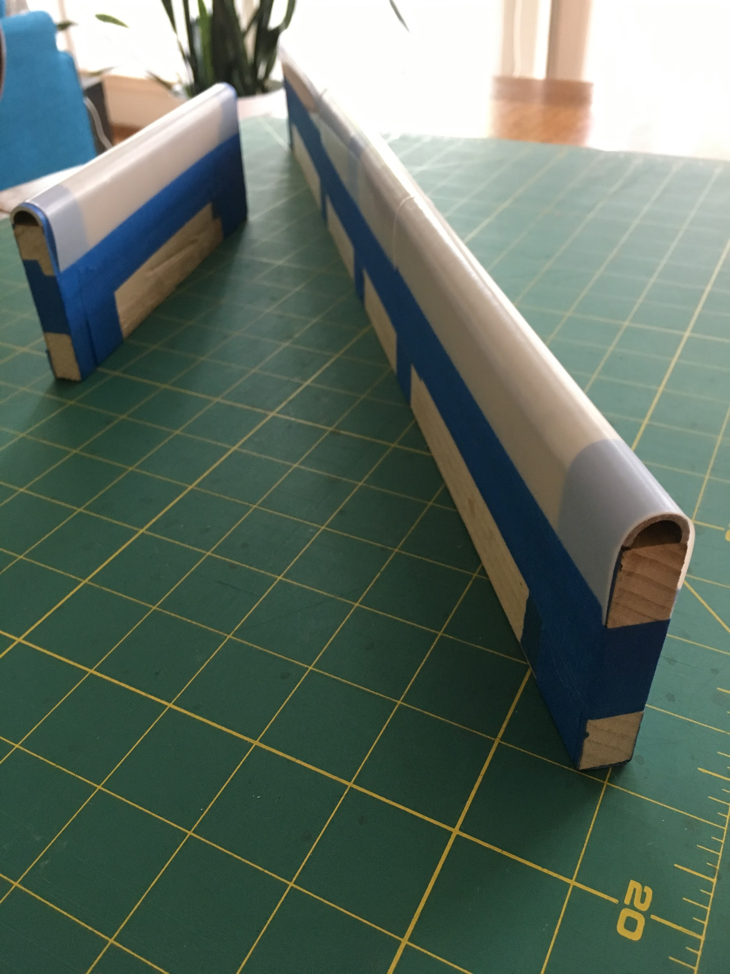
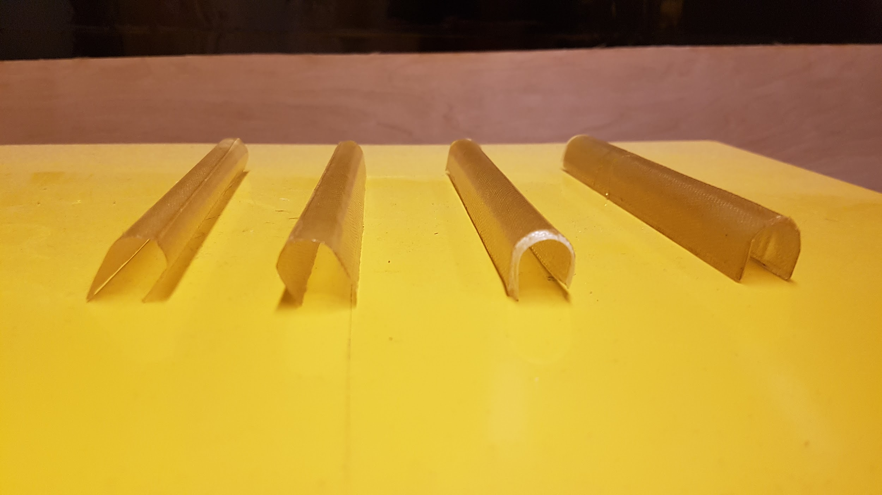
OreSat Deployable Antennas
2018
Tape Spring Manufacturing
Plain weave E-glass fiberglass
Pre-impregnated with epoxy resin
4 layers at specified orientations (-45, 0, 90, 45)
Cured while vacuum sealed at recommended temperature
Plain weave
Vacuum cured @ 310 F
Fiberglass Pre-preg.
½” diameter molds
Results
Oregon Small Satellite Project

Slide 11
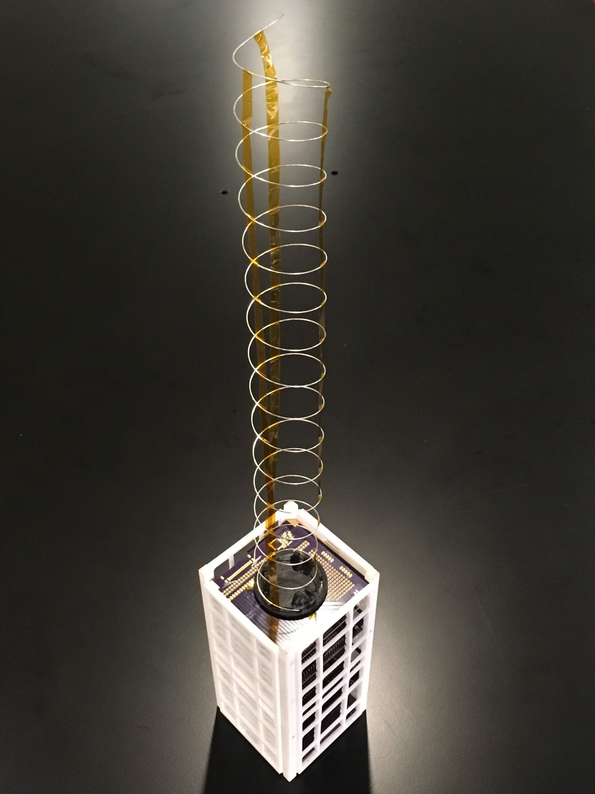
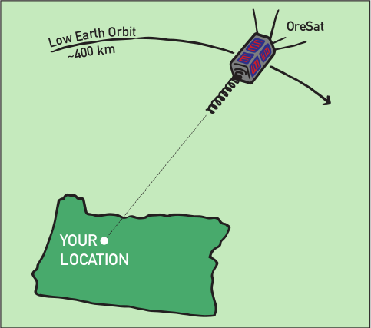
OreSat Deployable Antennas
2018
S Band Helical Antenna
Points at Oregon as it passes overhead
Transmits high-definition video signal to handheld ground stations made by high school students
Oregon Small Satellite Project

Slide 12
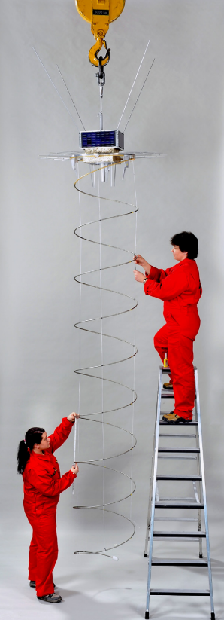
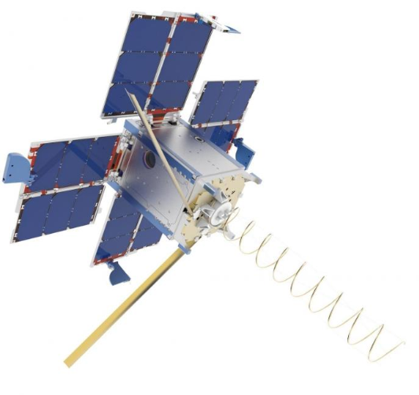
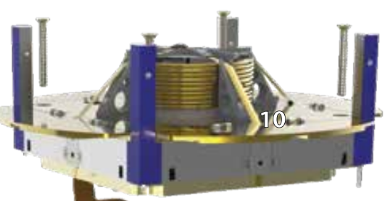
OreSat Deployable Antennas
2018
Design Challenges
Compact down to less than 15 mm and extend to 460 mm
Deploy autonomously after ~6 months without tangling
Hold shape accurately enough for RF transmission
Maintain stability under rotational acceleration
Achieve high-gain transmission with fewer turns
Design Inspiration
AISat (India)
GOMX-3 (Denmark)
Prometheus (New Mexico)
Oregon Small Satellite Project

Slide 13
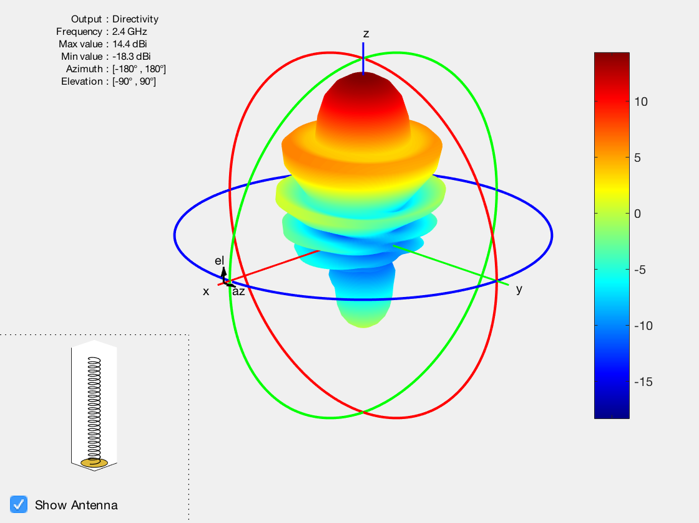
OreSat Deployable Antennas
2018
Uniform Helical Antenna
Designed to emit an axial-end fire radiation power with high gain characteristics.
Communication to ground station on WiFi channel 802.11b.
Antenna is stowed as a compressed spring, releasing stored potential energy upon deployment.
Experimented with non-uniform diameter designs to facilitate concerns with packing efficiency
Oregon Small Satellite Project

Slide 14
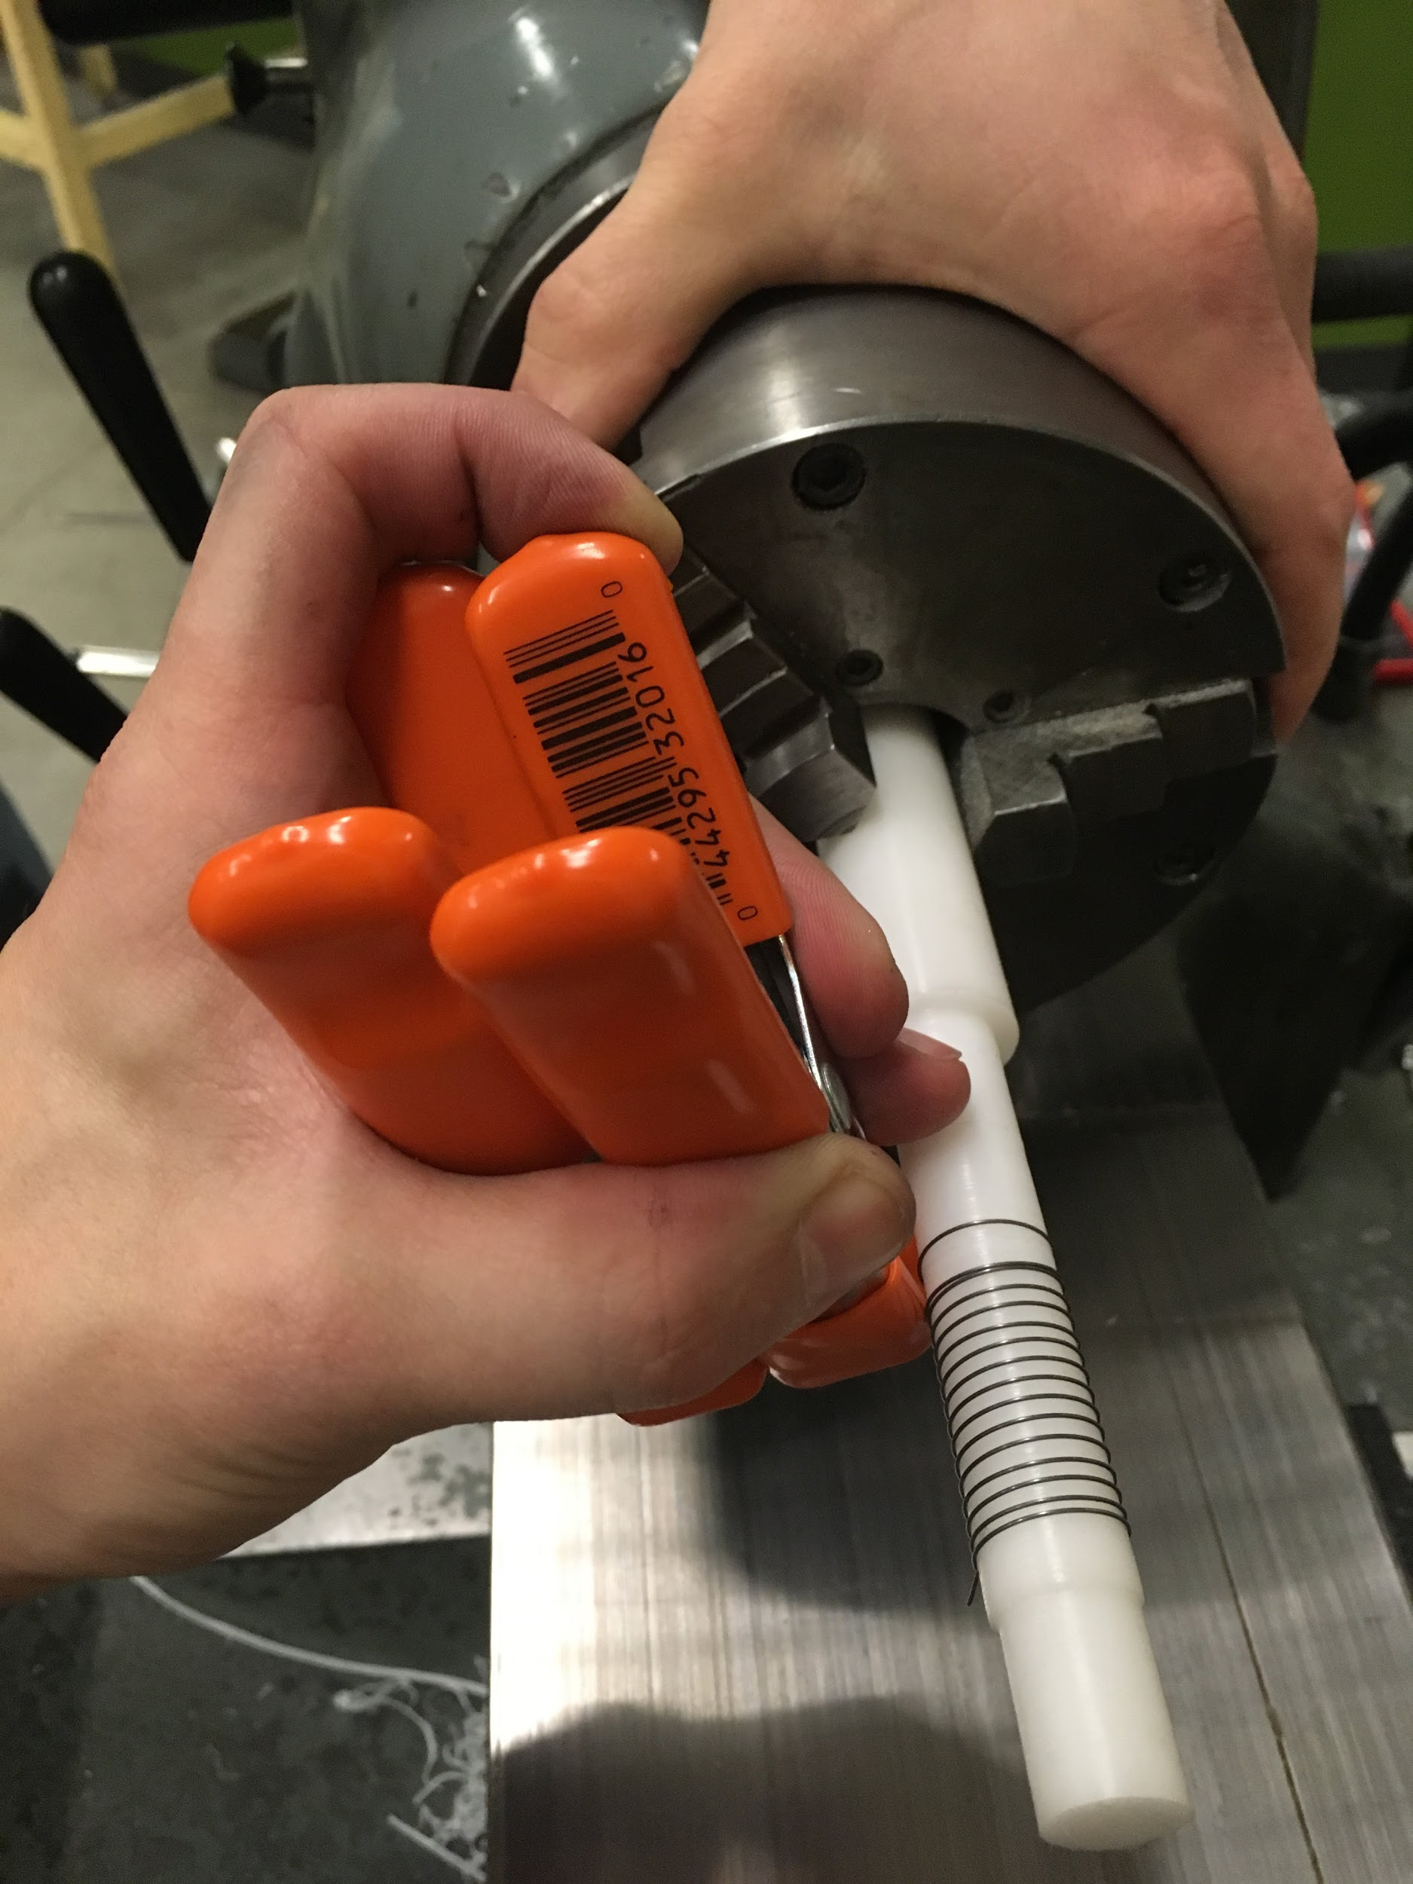
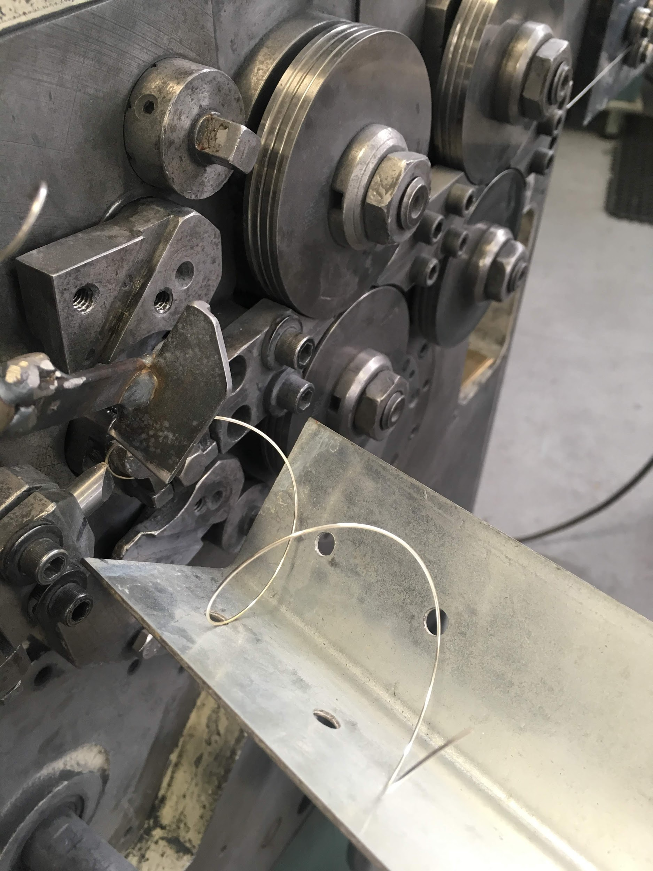
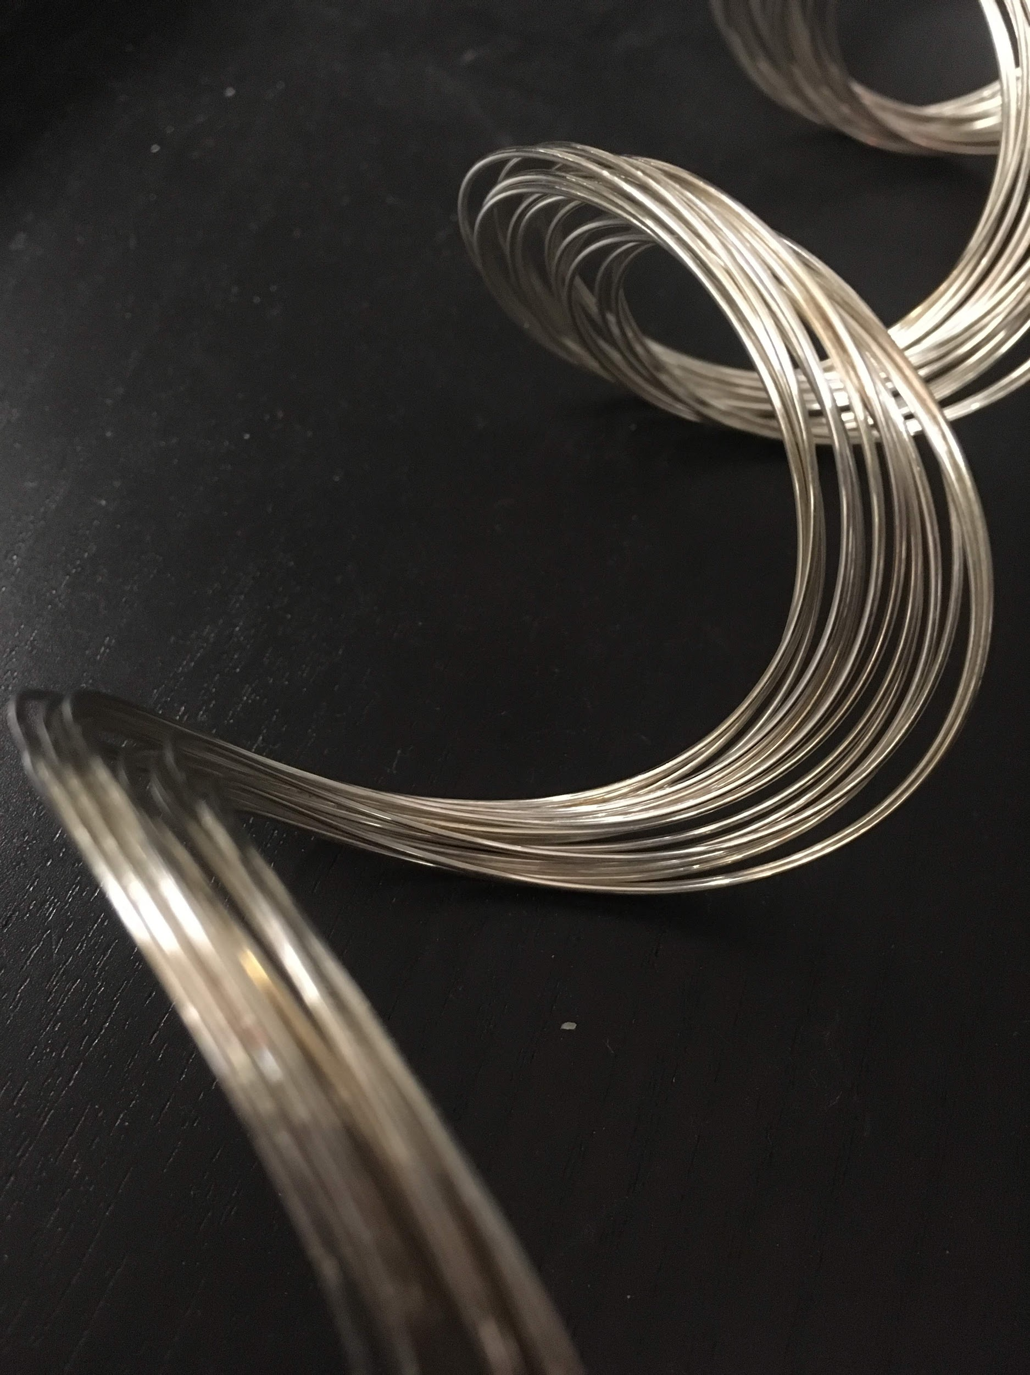
OreSat Deployable Antennas
2018
Spring Manufacturing
Thin gauge for compact storage
Beryllium copper for resilience
Silver coating for electrical properties
Difficult with such extreme proportions
Numerous attempts to make by hand
Varying levels of success
Contracted local professionals
Oregon Small Satellite Project

Slide 15
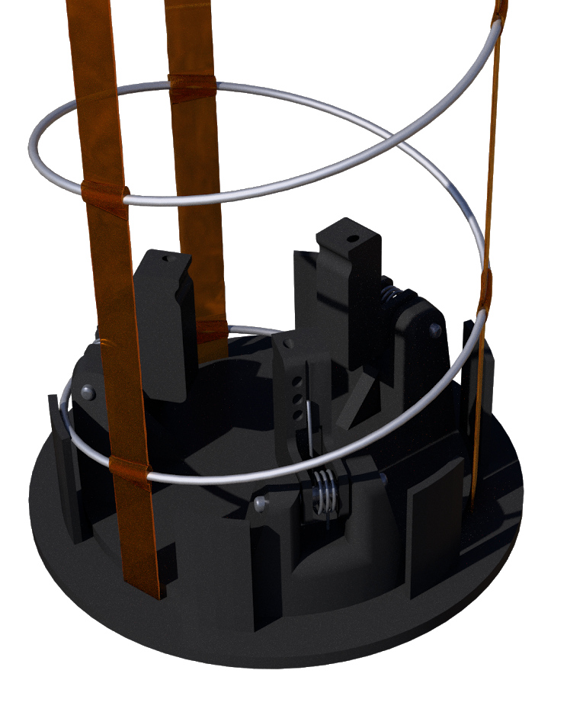
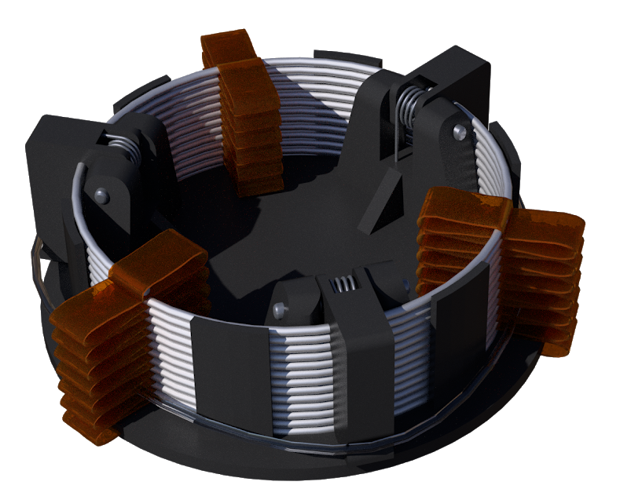
OreSat Deployable Antennas
2018
Deployment
Spring-loaded mechanism mounted to PCB
Three hinged arms compress the spring
Circumferential burn wire releases the arms
Constraint
Tethers used to maintain compression in the deployed spring, providing rigidity
Similar designs use fishing line
Initially opted for ribbons
Settled on ultra-thin Kapton strips
Simple, light-weight, compact
Oregon Small Satellite Project

Slide 16
OreSat Deployable Antennas
2018
Special Thanks
Andrew Greenberg and Glenn LeBrasseur
for sponsoring the project and herding all of the electrons
Gerald Recktenwald
for providing fantastic guidance as our faculty advisor
Dependable Springs
for the precise manufacturing of our helical antennas
HP Dynamics Lab
for their generous assistance with all things vibration
HP Model Shop
for supplying high-quality 3D prints of our design prototypes
Oregon Small Satellite Project

